Slide 1
Microcomb weekly meeting – KW 13
Recap
Status
Optimization of PCF for supercontinuum generation
No EDFA for soliton generation + Main amplifier reaches 5 W.
For 10 W, chiller and plate are available in house, although depends Sascha. Pump diodes from BlueCut
Plan
Build PCF for supercontinuum generation
Publication // Conferences
SPIE Astronomical Telescopes + Instrumentation 2022 in Montréal. Yuanjie submitted abstract but we could made a manuscript with our work.
Manuscripts due: 22 June 2022 (https://spie.org/conferences-and-exhibitions/astronomical-telescopes-and-instrumentation/presenters/abstract-submission-guidelines)
Abstract conference EPFL - Abstract Photon Nottinham?
Writing paper about work done so far.

Slide 2
Supercontinuum generation
Parameters
[1] Untapered region input
[2] Tapering
[3] Waist
[4] Uptapering region
[5] Untapered region output
The optimum design would have a look like this, allowing an easily integration with a connector.
Otherwise, to get the higher broadening, might be needed to cut throughout the fiber and test. This not only represents an unnecessary waste of time but also, the integration is not easy given the fiber is much smaller..
[2]
> 1 cm
[1]
[4]
[5]
[3]
Taper section = [2] + [3] + [4] < 20 cm
Region | Minimum value | Maximum value | Observations
1 | 1 cm | 3 cm | Too long would stretch the pulse more than desire
2 | 3 cm | 17 cm | Too sharp, implies a higher level of losses and also it might end up in reflection that could compromised the amplifier!
3 | 1 cm | - | Limitations lie in the scale
4 | 1 cm | 4 cm | Same as 2, a too sharp might affect via reflections although it is not clear how.
5 | 1 cm | - | The length of this region is actually irrelevant given all the broadening was already achieved in the previous sections

Slide 3
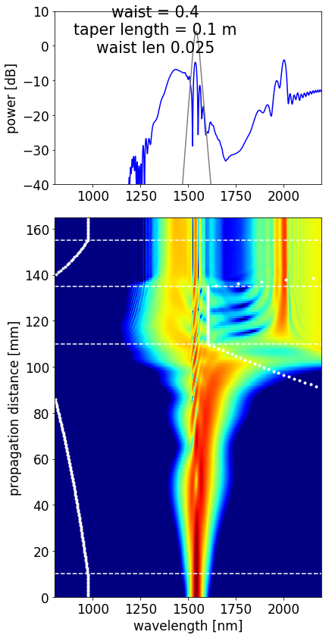
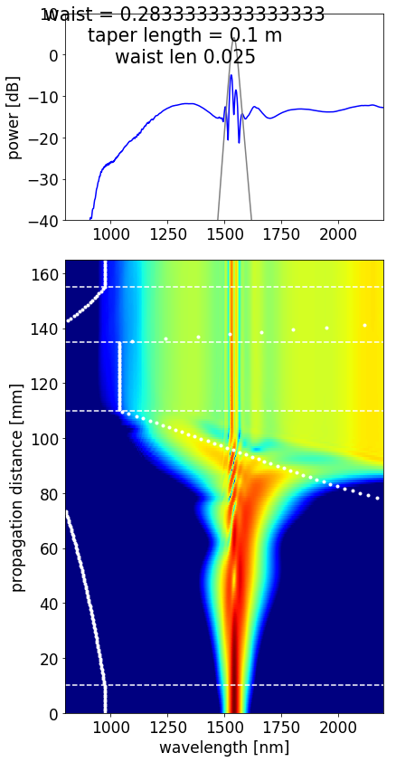
Criteria defined
High wavelength accessed
Low wavelength accessed
Waist scale defined by allowed transmission
Larger broadening available with available setup and within fabrication limitations

Slide 4
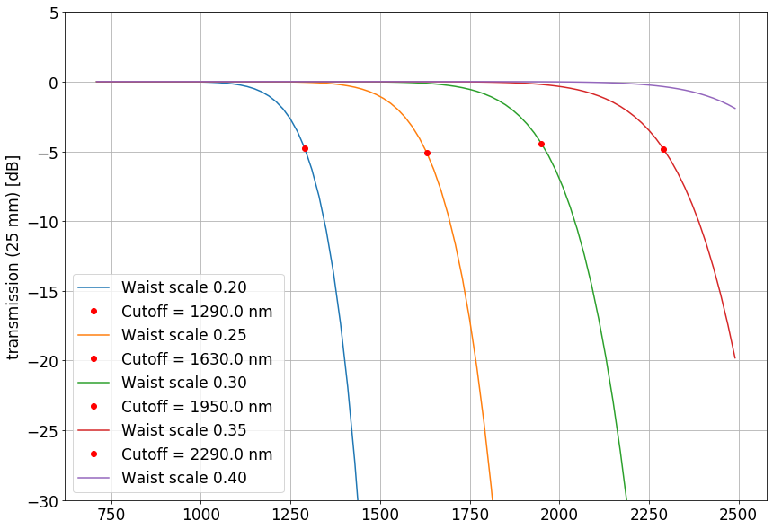
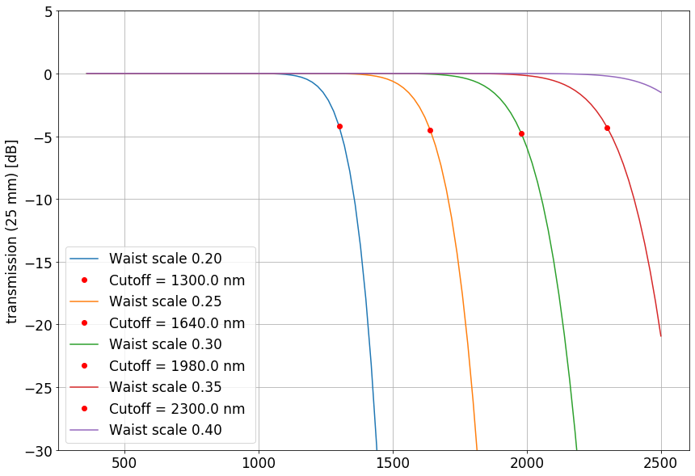
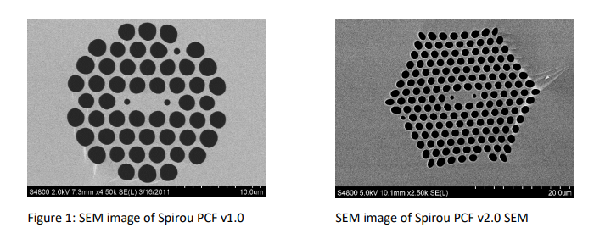
Ideal
Ideal
A limitation for the waist scale* seems clear when we see the wavelengths that are transmitted according to this value.
The best option would be a waist scale of 0.40 (50 µm). However, such large waist it is not optimum for broadening.
*Waist scale is a measure relative to the fiber diameter at the beginning (125 µm). Say, e.g., waist scale is 0.25 means the fiber diameter at the waist is 0.25 x 125 µm = 31.25 µm

Slide 5
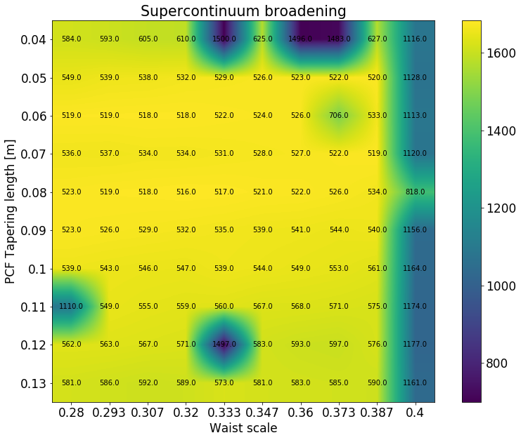
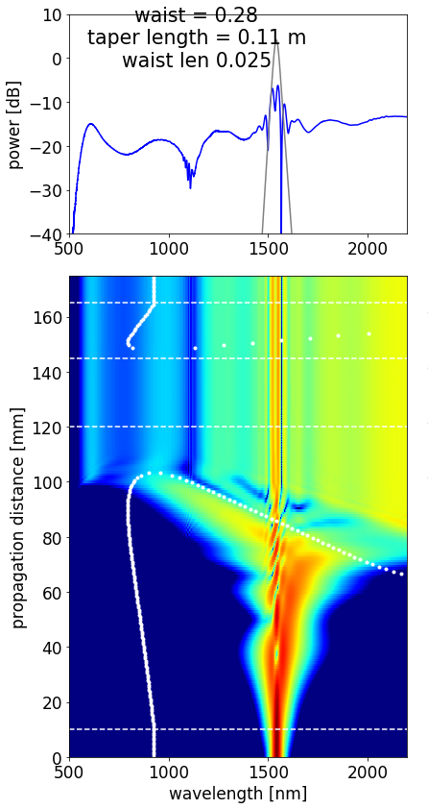
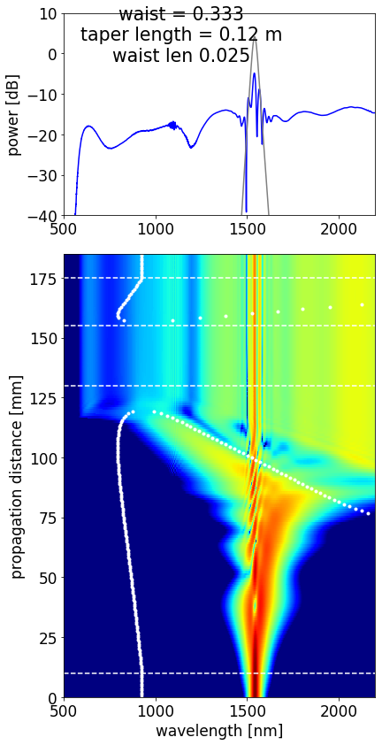
High power PCF version (8 W coupled, 110 fs pulse duration)
.
.

Slide 6
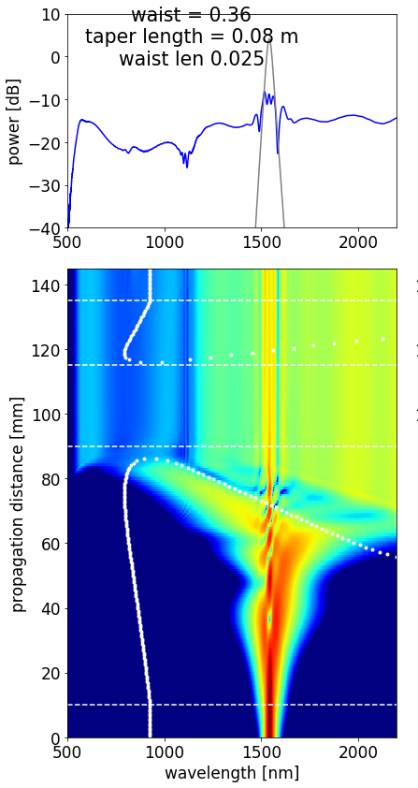
High power PCF version (8 W coupled, 110 fs pulse duration)
Colors = Broadening range
Numbers = Lower wavelength accessed
Higher wavelength is the same for all fibers given the transmission limitation

Slide 7
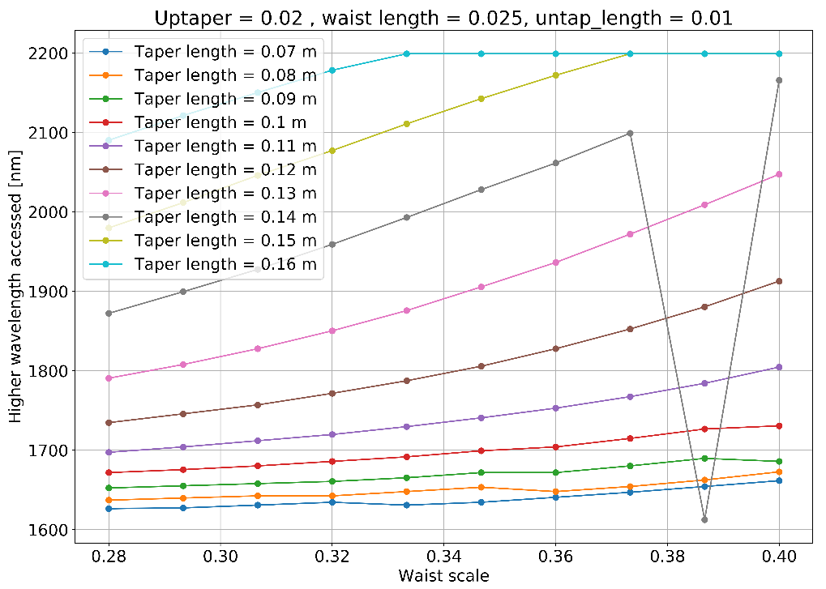
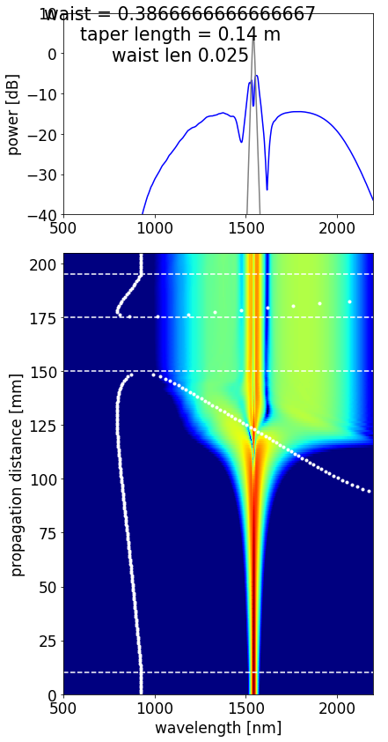
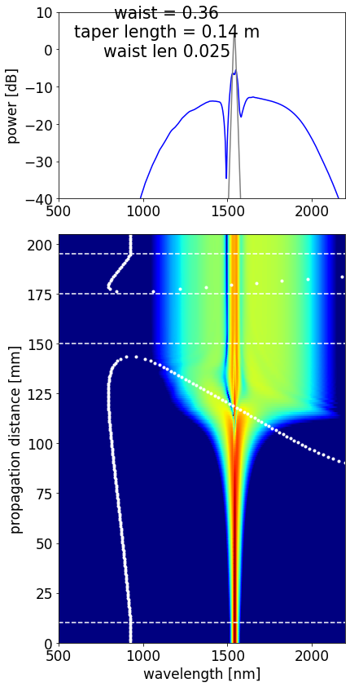
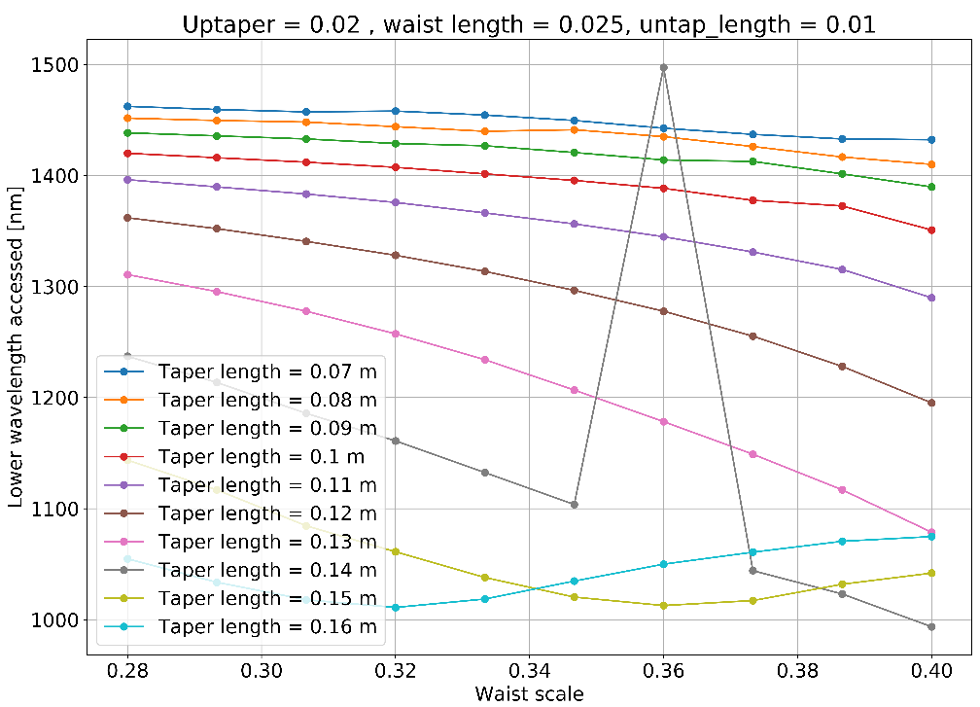
Low power PCF version (4 W coupled, 230 fs pulse duration)

Slide 8
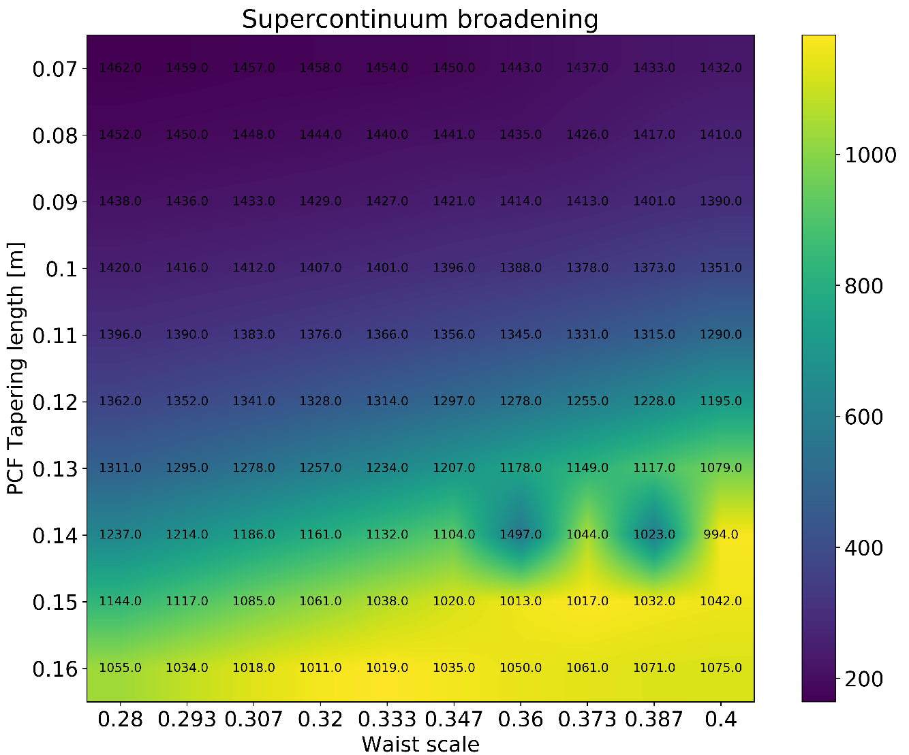
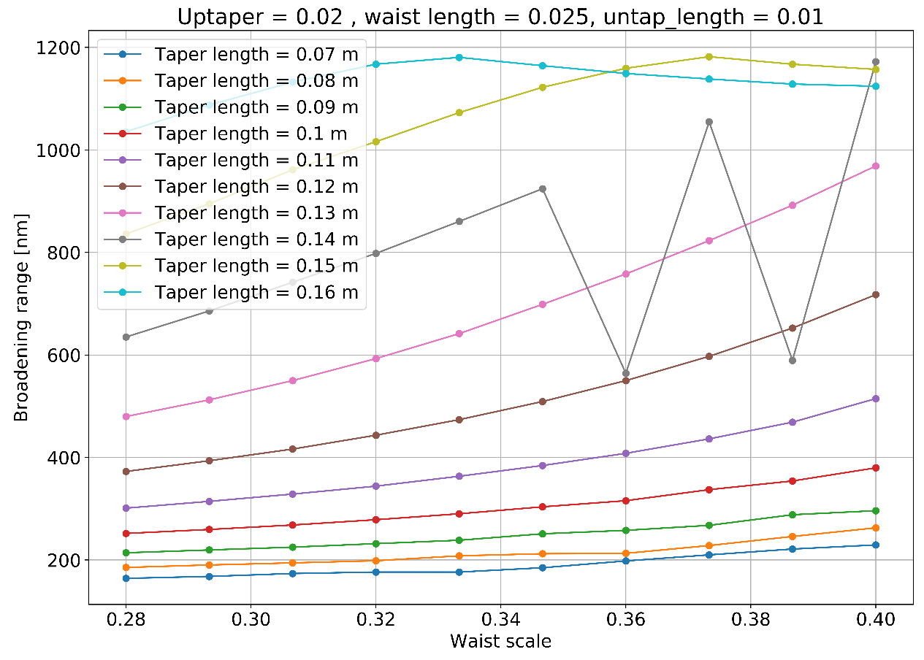
Low power PCF version (4 W coupled, 230 fs pulse duration)
Optimal for high power version

Slide 9
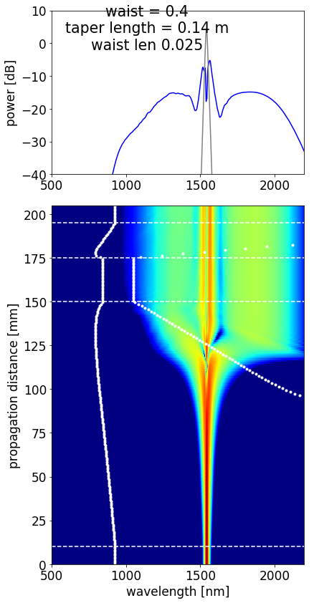
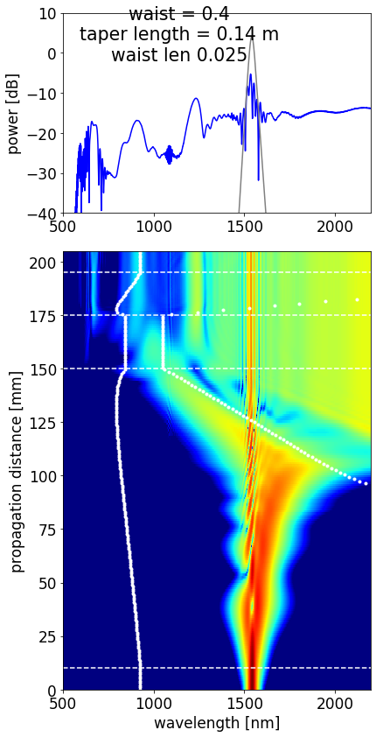
Low power PCF version (4 W coupled, 230 fs pulse duration)
4 W, 230 fs
Same with higher power and lower pulse duration
8 W, 110 fs

Slide 10
Summary
Parameter | High power version | Low power version | Fabrication limitations
PCF | Spirou v2 | Spirou v2 | -
Tapered length | 8 cm | 14 cm | 17 cm
Waist scale (core diameter) | 0.36 | 0.40 | > 0.1 (12.5 µm)
Waist length | 2.0 cm - 2.5 cm | 2.0 cm - 2.5 cm | > 1 cm
Up-tapered region | 2 cm | 2 cm | > 1 cm
Lower wavelength achievable | 522 nm | 994 nm (800 nm) | -
Higher wavelength achievable | 2300 nm | 2150 nm (2150 nm) | Depends on fiber and waist diameter
Spectral broadening range | ~1750 nm | ~1150 nm (1350 nm) | -
Coupled input power | 8 W | 4 W (8 W) | -
Pulse time duration | 110 fs | 230 fs (110 fs) | -
Total tapering section length | 12.5 cm | 18.5 cm | < 20 cm
 | Preference | Observations
Power requirement | Low power version | 5 W
Amplifier complexity | Low power version | No need for a chiller
Broadening achieved | High power version | 1750 nm of broadening

Slide 11
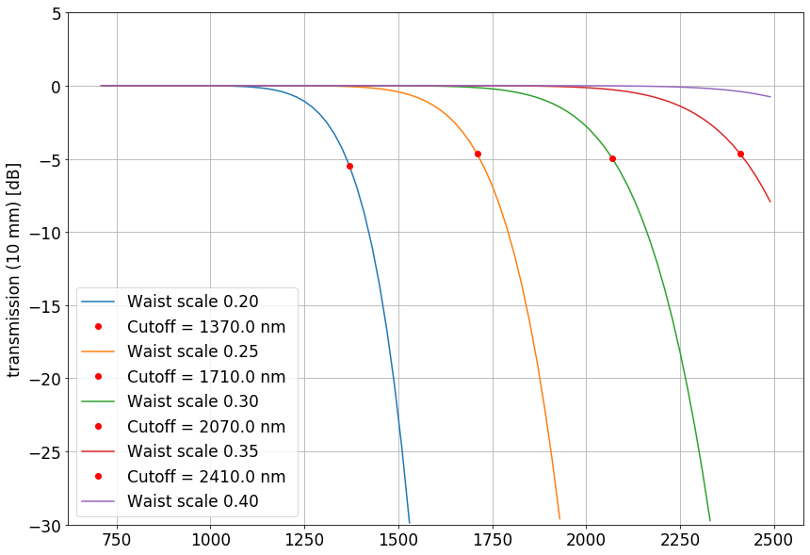
A limitation for the waist scale* seems clear when we see the wavelengths that are transmitted in the fiber according to this value.
The best option would be a waist scale of 0.40 (50 µm). However, later will be seen that such a large waist it is not optimum for broadening. A trade-off should be found here.
*e.g., waist scale is a measure relative to the fiber diameter at the beginning (125 µm). Say waist scale is 0.25 it means that the fiber diameter at the waist would be 0.25 x 125 µm = 31.25 µm
Ideal

Slide 12
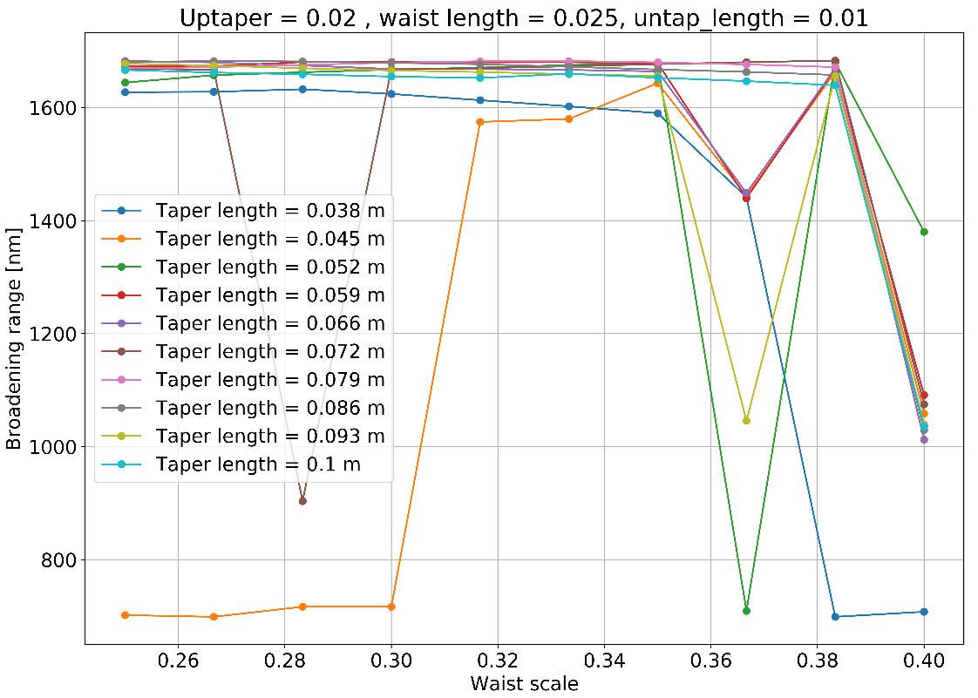
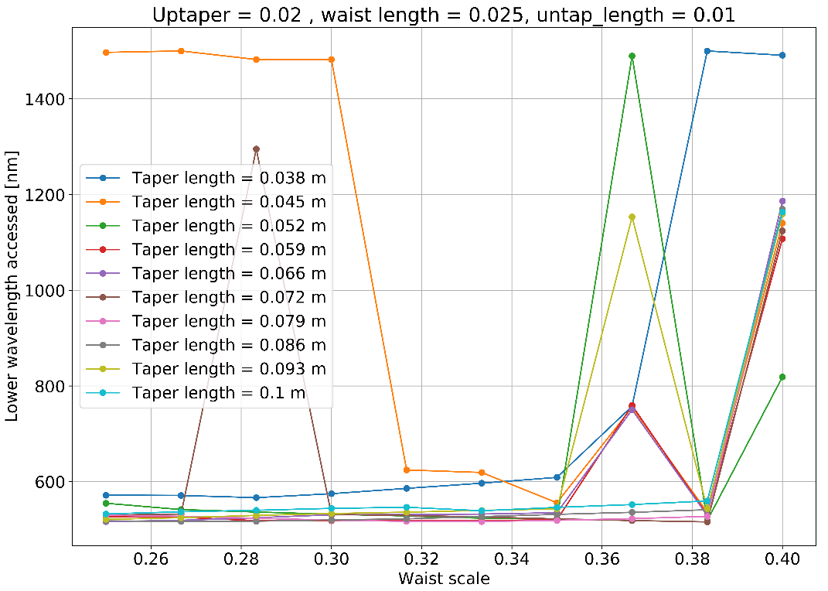
Same with fiber two
**
*

Slide 13
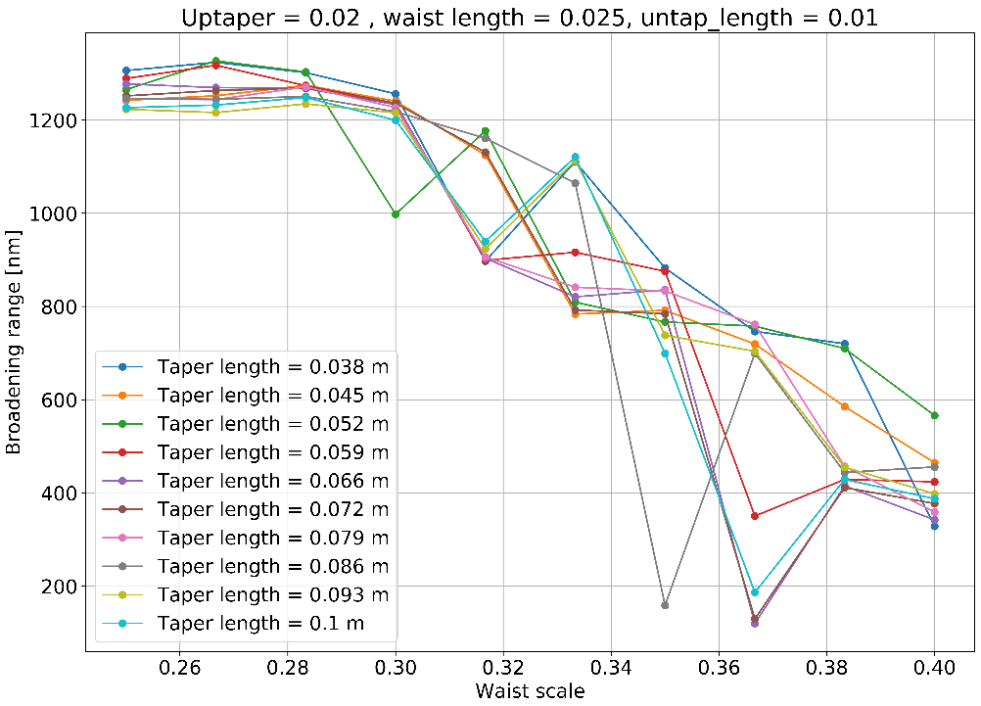
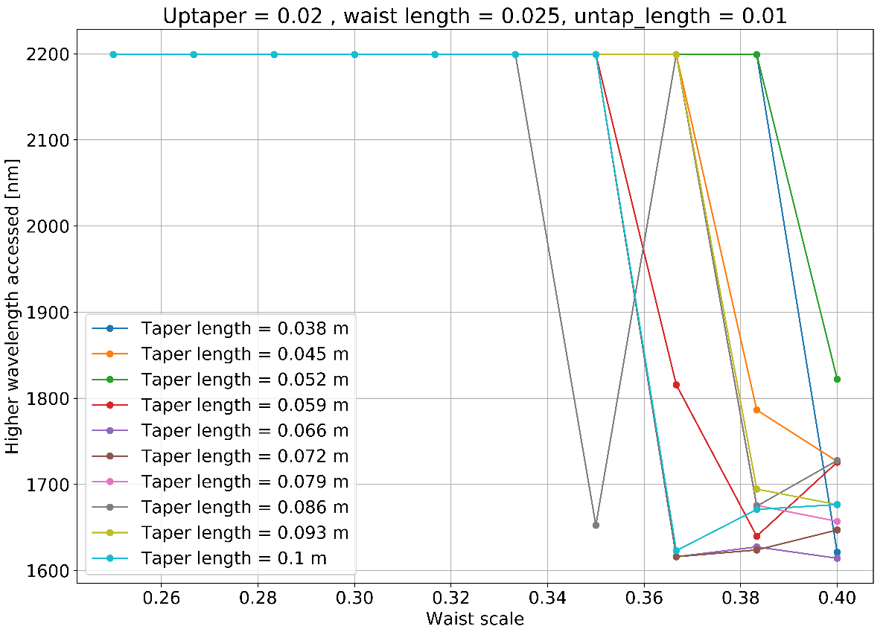
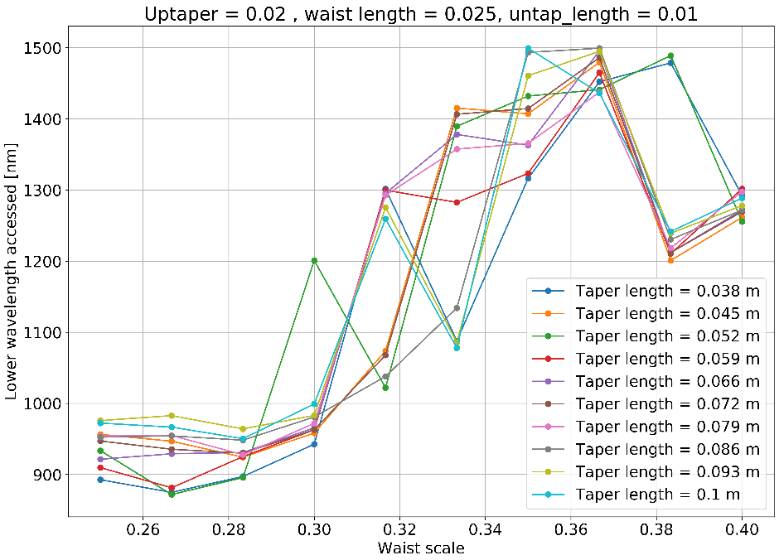
Waist scale variation with fixed waist length = 2.5 cm
Shorter fiber achieves lowest wavelengths
High wavelength depends exclusively on the transmission available by the waist.

Slide 14
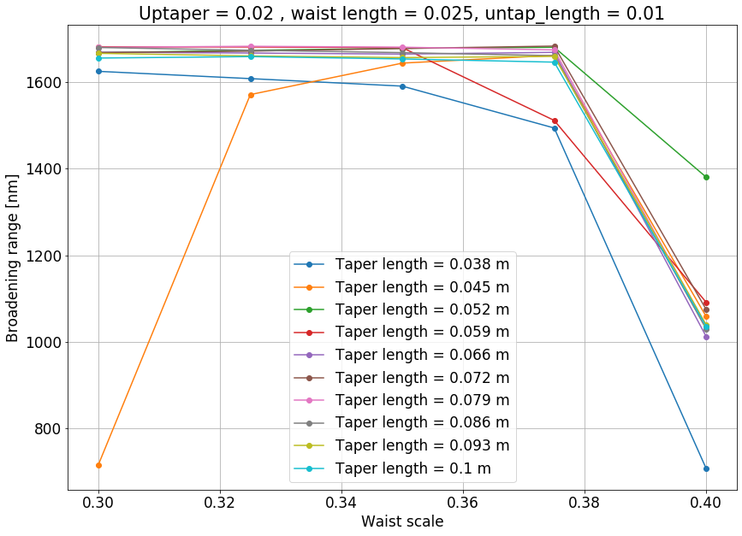
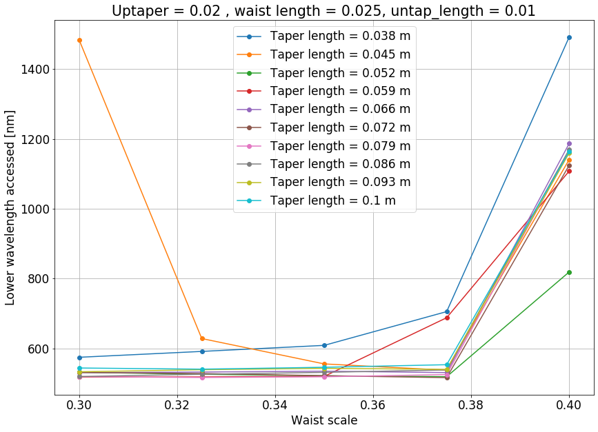
Same with fiber two

Slide 15
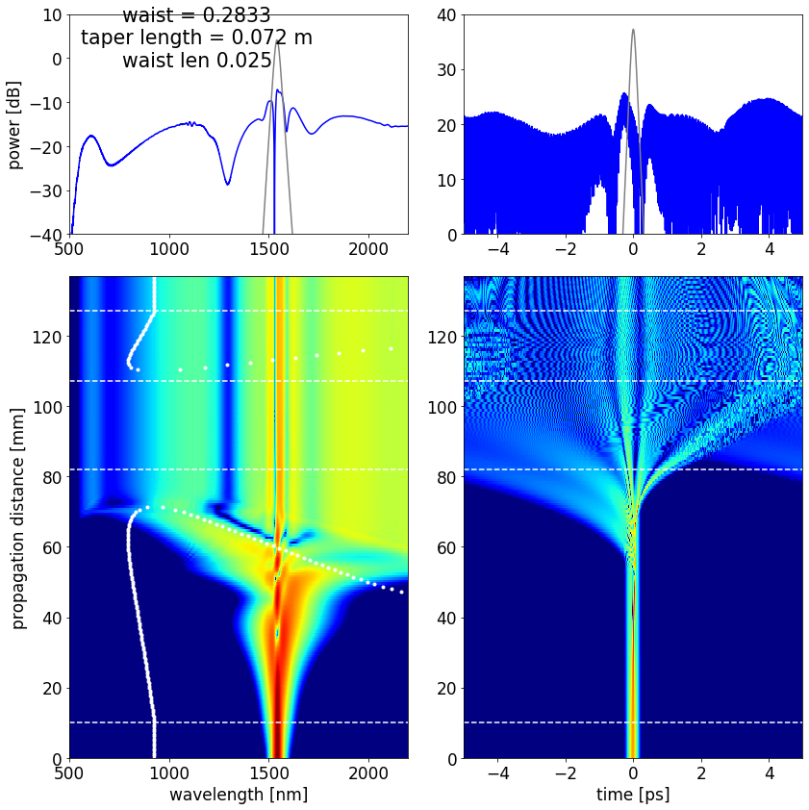
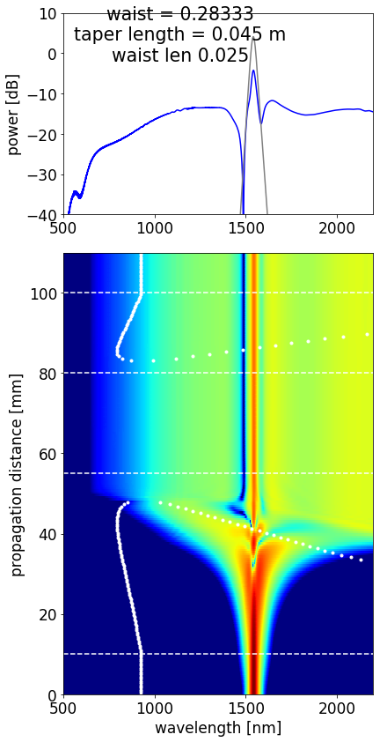
**
*

Slide 16
High energy solitons → Dispersive wave. No generation of short wavelength is generated by solitons
Soliton always going to the lower energy. Larger wavelength.
Dispersive waves from independent solitons are in charge of the shorter wavelengths part of the broadening.
Small enough core. Raman for asymmetric. It compresses the
pulse. Gets shorter. Where the pulse is short enough + peak power gets higher. Explodes.
When the zero dispersion is closed to pump, everything happens?
The core is not small enough. Non enough intensity for nonlinearities.
Only SPM.
Self phase modulation. The pulse gets stretched. GVD is anomalous.

Slide 17
Gap because we didn’t cross the Zero Dispersion. Still anomalous dispersion! You cannot make shorter wavelengths after.
Still anomalous.
Dispersive wave from the highest intensity wave.
Many dispersive waves from the many solitons and they merge.
The gap will be real.
Zero-dispersion wavelength is the wavelength or wavelengths at which material dispersion and waveguide dispersion cancel one another.
As a straightforward solution tapered fibers and holey fibers or photonic crystal fibers (PCF) were produced. Essentially they replace the cladding by air. This improves the contrast of refractive indices by a factor of 10. Therefore, the effective index is changed, especially for longer wavelengths. This type of refractive index change versus wavelength due to different geometry is called waveguide dispersion. As these narrow waveguides (~1-3 μm core diameter) are combined with ultrashort pulses at the zero-dispersion wavelength pulses are not instantly destroyed by dispersion. After reaching a certain peak power within the pulse the non-linear refractive index starts to play an important role leading to frequency generation processes like self-phase modulation (SPM), modulational instability, soliton generation and soliton fission, cross phase modulation (XPM) and others. All these processes generate new frequency components, meaning that input light with narrow bandwidth expands into a wide range of new colours, through a process called supercontinuum generation.
High energy solitons → Dispersive wave. No generation of short wavelength is generated by solitons
Soliton always going to the lower energy. Larger wavelength.
Dispersive waves from independent solitons are in charge of the shorter wavelengths part of the broadening.
Small enough core. Raman for asymmetric. It compresses the
pulse. Gets shorter. Where the pulse is short enough + peak power gets higher. Explodes.
When the zero dispersion is closed to pump, everything happens?
The core is not small enough. Non enough intensity for nonlinearities.
Only SPM.
Self phase modulation. The pulse gets stretched. GVD is anomalous.

Slide 18
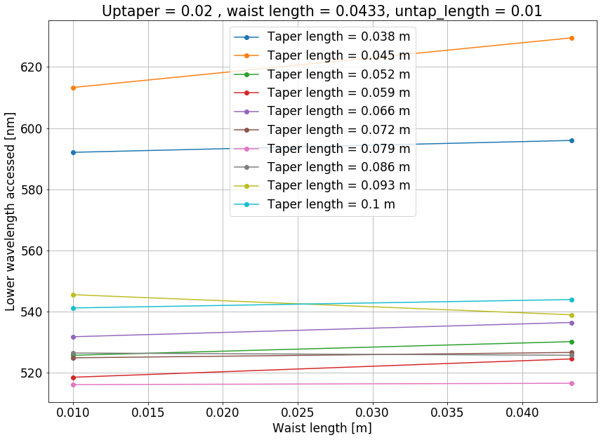
Waist length variation with fixed waist scale = 0.3 (37.5 µm)
Shorter fiber achieves lowest wavelengths
High wavelength depends exclusively on the transmission available by the waist
A better alternative consists in the PCFv2 for SPIROU which cutoff frequency is improved in the larger wavelengths…

Slide 19
Comments
Shorter waist is better. How many dB loss per cm. The shorter the waist the better.
Tranmission depends on the air holes.
Transmission depends on the diameter of the core.
Bigger core less nonlinearity, less intensity
Therefore, short waist, small core.
1 cm is already quite short. You cannot make it shorter.
Backcut.
Version 2 has a similar design but the tranmission is better for longer wavelengths. 5 dB is way too lossy. The holes diameter are not so different. 5% bigger.
0.335 waist scale. 4 cm of waist.
More airholes would give larger wavelength. Does not leak the light. Better confinement. More intensity.
Maximum is 7 rings. 8 is too comlpicated.
The inner ring is the one that is defining the air filling fraction. All the other does not matter anymore. Spirou v2 makes change in the inner region. Transmission is better. The broadening is the same but the transmission gets better.

Slide 20
Comments
The smallest the waist diameter, the higher the losses. Therefore, sometimes it is needed to be cut so the broadening can be recover.
The waist is needed because we need to go back to higher diameter for connectors.
You get the broadening but you don´t transmit anything. Short wavelength is transmitted. Large wavelength is blocked.
The broadening happens BEFORE the zero dispersion crossing with each other. They have two zero dispersion. One is normal and one is anomalous.
For 1 µm is necessary to wait till the crossing and the broadening happens. For 1.5 we do not need to wait.
The lower side is always transmitted.
Hence, frequencies in this region are better phase-matched to the pump laser, thereby enhancing comb generation. Dispersive waves play a crucial role in self-referencing soliton microcombs, as explored in the next chapter
Gap because we didn’t cross the Zero Dispersion. Still anomalous dispersion! You cannot make shorter wavelengths after. Still anomalous. Dispersive wave from the highest intensity wave. Many dispersive waves from the many solitons and they merge. The gap will be real.

